Slide 1
Red Team Fundamentals
Caleb Fleming

Slide 2
Who Am I?
Caleb (please no “Mr. Fleming”)
ACE 2016
DoD Red Teamer
CCDC Red Teamer
Home Lab Enthusiast

Slide 3
Rules of the Road
Use this information for good
You will learn how to hack
Understanding offense is critical to building solid defense
I’m not covering much on how to not get caught, so please don’t try
Please ask questions
I’m not the one who gets a grade at the end of this week
Only you know what you don’t know
Please speak up if I gloss over content/acronyms you don’t know
This will be a mile high overview
I will be glossing over a lot of intricacies
Some exceptions may apply

Slide 4
Definitions
Attacker/Operator – Us
Victim/Target – Them
Implant/Agent – Tool that gives an attacker access to a victim
Many more to come

Slide 5
Challenge Problem
Gain initial access to PROCE domain
Elevate privileges and move around PROCE
Locate and exfiltrate 4 intel files located within the domain
Blend in as much as possible, people might be looking for you
Write a report detailing
Thought process/analysis you performed
Attack chain taken
Artifacts you generated
Artifacts you left behind

Slide 6
Our Tools
For this lecture and challenge problem we will be using Sliver (https://github.com/BishopFox/sliver)
Goal is to teach the fundamentals that apply to multiple toolsets
If you are interested in this field, I recommend experimenting with multiple tools
Merlin
Metasploit/Meterpreter
Mythic
Covenant
Etc.

Slide 7
Lets Dive In!

Slide 8
Attacker Mindset
“Defenders think in lists. Attackers think in graphs. As long as this is true, attackers will win.”
– John Lambert, General Manager, Microsoft Threat Intelligence Center

Slide 9
Define Your Objective
What do you want to gain by attacking your target?
Information?
Effects?
Access?
Requires that you know something about your target. RECON!
Find as much information you can about your target
Open Source Intelligence/Reconnaissance (OSR)
BEFORE you do anything else
Remember that your objective might evolve as you learn more

Slide 10
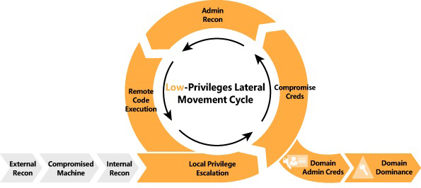
“Cyber Kill Chain”
https://ptgmedia.pearsoncmg.com/images/chap1_9780135752036/elementLinks/F01XX01.jpg

Slide 11
Keep your objective in mind
What information am I missing to find my objective?
What steps do I need to take to get closer to my objective?
Do I need to redefine/expand my objective?
WARNING:
It is easy to get lost if you forget about your objective
Every step you take should be intentional
At every point of the process, you should be able to describe WHY you are doing what you are doing

Slide 12
Be Blendy
Understand what your actions look like to an outside observer
Does what you are doing look “normal”?
Do users normally browse to HTTPS sites? -> yes
Do critical servers with no users browse to HTTPS sites? -> no
Do new files named “malware.exe” show up on your desktop randomly? -> I hope not
This is commonly referred to as tradecraft and I could spend a ton of time talking about it, but we don’t have enough time ☹

Slide 13
Read. All. The. Words.
Attackers often sift through a ton of information
Users often have tons of files
Network stores have even more files
Commands often return a lot of output
Nuggets of critical information are often buried next to junk
It is critical that you read all the output you get back
Looking at != Reading. Take your time. It is worth it

Slide 14
Backend Infrastructure

Slide 15
Attack Station
Computer used by an operator
Contains the tools the operator intends to use
Ideally ephemeral
can be changed
doesn’t always need to be on

Slide 16
Team Server
Allows multiple operators to work together
Serves as the central management point for your operation
Several tools do not have a concept of a team server
Agents call back to a single attack station
Makes collaboration more difficult
Most new tools at least try to implement a team server

Slide 17
Listeners
Listens for incoming agent connections
Multiple configuration options
Important that they match the settings that the agents are expecting to call back to

Slide 18
Redirectors
Sometimes (most of the time) it is not ideal for agents to call back directly to your teamserver
Limits creativity on where the traffic is going to
Makes moving when IPs are found and blocked more difficult
Opens your team server to fingerprinting, discovery, and exploitation
Redirectors solve this by providing multiple locations that will redirect/tunnel traffic back to your teamserver
Easier to replace since the redirectors don’t store state, just handle traffic

Slide 19
Redirectors (cont)
Can be implemented in multiple ways
Firewalls (NAT)
Proxies (NGINX, Apache)
Tunnels (SSH, VPN)

Slide 20
Payloads
Agents don’t magically appear (as much as we might hope they will)
Payload is the artifact that creates an agent when executed
Can take many different forms
Executable
Shellcode
Script
Office Macro
Etc.
Generated by the operator according to operational need
Settings need to match the settings of the listener you want it to use

Slide 21
Payloads: Stagers
Minimal code needed to download and execute the full agent
Small, fits in more places and can be less noticeable
Requires access to reach out to your infrastructure to download the full agent to execute
Goes by many names
Stagers
Download Cradles
Stage Zero

Slide 22
Payloads: Stage-less
Stage-less payloads contain all of the code needed to run the agent from the beginning
Often larger than staged payloads
Do not require downloading of additional code to function

Slide 23
Infrastructure Testing
Critical that you test all of the parts of your infrastructure before use
Goal is to find any issues while you control ALL of the pieces
When you start your operation, your opponent gets a say
Network oddities, security products, or just bad luck can impact you
Testing eliminates many unknowns so at the very least you know that what you control works as expected
Easiest way to test is to execute your payload on a box you control, if you get a callback then you know everything works as expected

Slide 24
Lab #1 – Infrastructure Setup
Connect to your team server
Start an HTTPS listener on port 443
Generate a payload to call back to that listener
Test to ensure that your callback works as expected

Slide 25
Initial Callback
You get a callback…. Now what?

Slide 26
How did you get your callback?
There are many ways to get your initial access
Phishing
Insider Threat
Exploit/Remote Code Execution (RCE)
Leave a malicious USB in the parking lot
Break in
Only limited by your creativity (and your rules of engagement)
Later lectures will cover this in more detail

Slide 27
Now what?
The stars have aligned, and you have a callback, what now?
We are here
https://ptgmedia.pearsoncmg.com/images/chap1_9780135752036/elementLinks/F01XX01.jpg

Slide 28
Initial (Local) Recon
When you first land, you know probably know very little
Gathering information is critical to orient yourself in the network
What user are you?
Are you an admin? What groups are you in?
What OS are you on?
Is anyone else logged into this machine?
Are you in a domain?
What defenses are here?
You should initially focus on enumerating the local system, the network can wait until you are oriented

Slide 29
Network Recon
After you are comfortable on your local machine, start to look outward
Potential questions to ask
What other users are there in the domain?
What domain groups are interesting? Are there any with “admin” in the name?
Who is a member of those interesting groups?
Where is my domain controller?
Are there services in the network? Is anyone on this machine using those services?
Are there any file shares that I could dig through?

Slide 30
Lab #2 – Enumeration
Enumerate the following on your initial callback
Your Username
Your Groups
OS
Domain
Domain Users
Domain Groups
Any interesting files?
“Shell” command will open an interactive powershell.exe
Google is your friend
Feel free to dig further on your local system when you finish, but find the above information first

Slide 31
Helpful Enumeration Commands
net user [/domain]
ipconfig
net localgroup
net group
dir / ls
Multiple sa-* tools in the sliver armory

Slide 32
Why Enumerate?

Slide 33
Why Enumerate?
Informs next steps
Helps us find our objective
Finds targets
Helps us hide
Might find something unexpected that changes our objective

Slide 34
Now what?
We have enumerated our local machine and network, what now?
https://ptgmedia.pearsoncmg.com/images/chap1_9780135752036/elementLinks/F01XX01.jpg
We are here

Slide 35
Local Privilege Escalation!
We need to find a way to increase the permissions that we have on our machine
This will allow us to access more files/credential material that we can use to pivot further into the network
Before we really dig into privilege escalation, we need to cover some more information on the privilege/permissions structure of our target

Slide 36
Linux privilege structure
Really only three tiers
Root – Able to do whatever you want
Admin User – Able to run things with root permissions if you want
Normal User – Stuck in normal user land
Running ‘id’ will tell you your user id and any groups you are in
If you are UID 0 then you are root
If you are in the “sudo” or “wheel” group then you are probably an admin
Running ‘sudo –l’ (dash lowercase L) will tell you if you have permissions to run things as root if you want to be sure

Slide 37
Windows Privilege Structure
MUCH MORE COMPLICATED
User permissions
Users can be individually assigned permissions
Permissions can be set for groups as well
If you want to dig deeper, you can dig into ACLs, DACLs, etc.
The most important thing for you to know now is that Local Administrators are generally equivalent to the sudo group on linux
Even if you are an “Administrator”, most programs you run will not have permissions to do whatever they want. Why?
Process Integrity Contexts!

Slide 38
Windows Process Integrity Contexts
Introduced in Windows Vista
Adds an additional layer of security to ensure admins only have special powers for specific actions. Prevents accidents and abuse
Processes are assigned one of three integrity levels
Low Integrity – Web browsers and untrusted guest users. Can’t do much
Medium Integrity – Most normal user processes
High Integrity – Admin processes
How do programs get a High Integrity Process? User Account Control

Slide 39
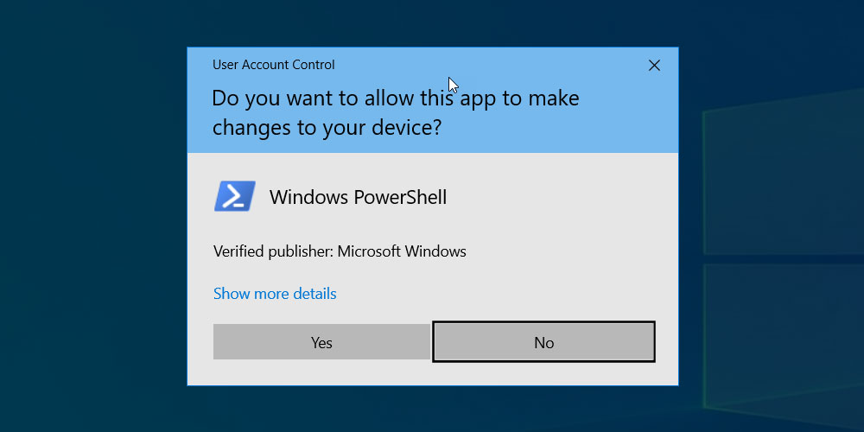
User Account Control (UAC)
Requires a program to specifically request or be started in a high integrity context (right-click -> “run as administrator”)
Requires that a user accept a prompt
The prompt is handled at the operating system level to prevent a program from attempting to circumvent the process

Slide 40
How do I get high integrity?
Fool a user into accepting the prompt for you
Accept the prompt yourself if you are interactively logged in
RDP
Sitting at their computer
UAC Bypass
Found and released from time to time
Patched by Microsoft quickly
Exploit a process with high integrity
Sometimes you can start a high integrity process on a machine over the network with credentials (more on this later)

Slide 41
Now what?
We have a high integrity process, what now?
https://ptgmedia.pearsoncmg.com/images/chap1_9780135752036/elementLinks/F01XX01.jpg
We are here

Slide 42
Credential Abuse
We have already enumerated everything our user can see
Time to steal other credentials to see what they can see!
System level permissions are nice to have full access to the local machine (see all files and users)
Other domain users credentials can provide access to other machines or resources that you previously did not have permissions to see
Always keep your objective in mind!

Slide 43
How to access credentials
Find them
You would be amazed what people will write down and store in files on disk/in network shares
Finding password lists can be a nice way to get around a network quickly
System level access is helpful to enumerate all files on your local machine
Steal them
Every process in windows has a “token” which contains credential material used to authenticate a user
System is able to copy (steal) the token from any running process, which allows you to access resources that the owner of that process would be able to access

Slide 44
Lab #3 – Credential Theft
Use your initial beacon to find/steal credentials
What user do you want to target?
Why?
Use your new credentials to enumerate files on a different machine

Slide 45
Now what?
We have stolen another users credentials, what now?
We are here
https://ptgmedia.pearsoncmg.com/images/chap1_9780135752036/elementLinks/F01XX01.jpg

Slide 46
For Tomorrow
Lateral Movement
Domain Recon
Start on the challenge problem!

Slide 47
Questions?

